Slide 1
Mayson Cabo Assistive Technology and How it Has Advanced

Slide 2
Diagnosis
Retinopathy of prematurity, challenges and outcomes?

Slide 3
History of Braille
Brief summary of Louis Braille
Creator of Braille

Slide 4
My Experience with Braille
When I started learning braille, and the challenges I faced.

Slide 5
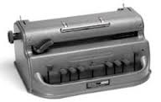
Braille Writer
The Braille writer and how it has impacted my life in writing braille.

Slide 6
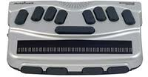
Braille note mpower
The first piece of technology I started with in the fith grade was the braille note mpower.

Slide 7
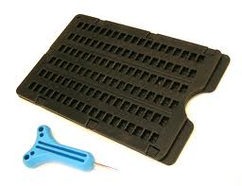
Experience with Slate & Stylus
Challenges I faced with the slate & stylus.
It was much harder to write braille with the slate and stylus. Positives and negatives.

Slide 8
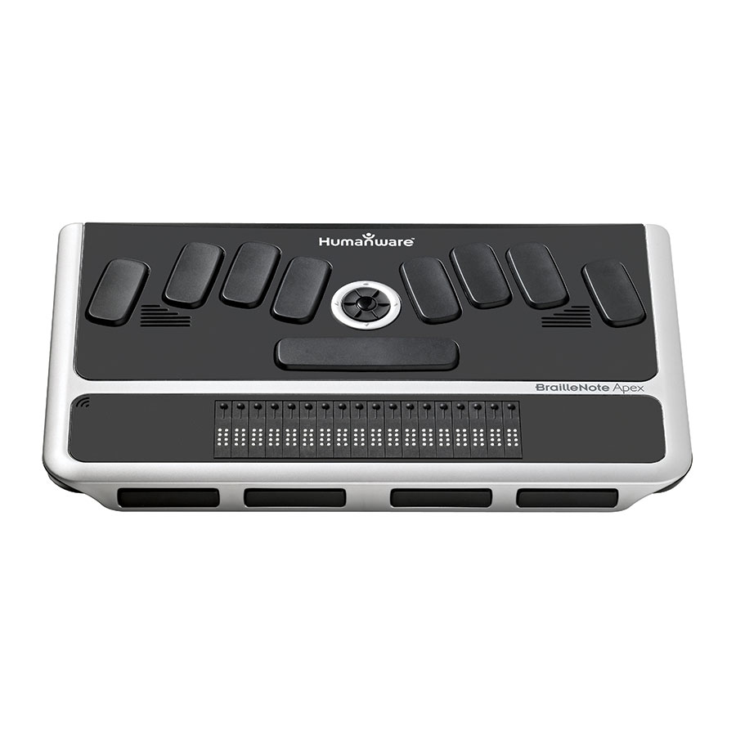
Braille Note Apex, a Big Leap in Technology!
Braille Note Apex, has really opened the doors of communication.

Slide 9
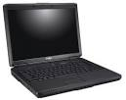
Laptop, the Biggest Leap in Technology
Laptops improve capabilities and possibilities.

Slide 10
Technology advances but challenges still present
Research paper
Challenges I faced while writing and completing this senior project paper.

